Slide 1

Using Airflow and DBT for DWH in Snowflake
PoC
© 2021 NTT DATA Corporation

Slide 2
Using Airflow and DBT for DWH in Snowflake
Purposes of the project:
Learn how to use Apache Airflow ( Open-Source ELT Tool ) to extract and ingest data
Learn how to use DBT (data build tool) for data transformation
Learn how to bind together Apache Airflow, DBT and Snowflake
Create a live-Demo for potential Customers.

Slide 3

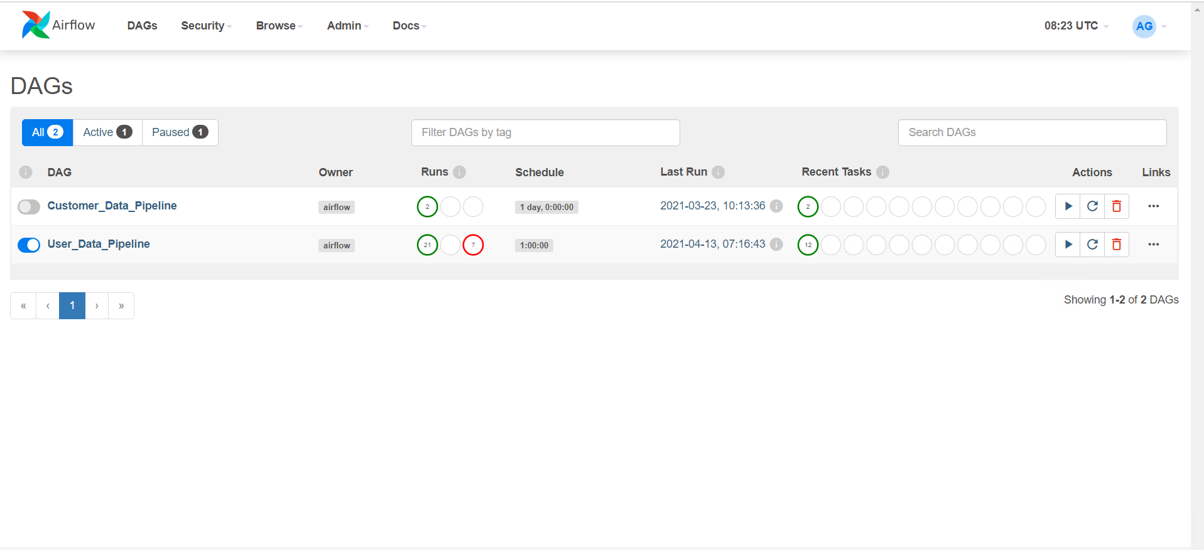
Using Airflow and DBT for DWH in Snowflake
Apache Airflow:
Apache Airflow is an open-source platform to Author, Schedule and Monitor workflows. It was created at Airbnb and currently is a part of Apache Software Foundation. Airflow helps you to create workflows using Python programming language and these workflows can be scheduled and monitored easily with it.

Slide 4
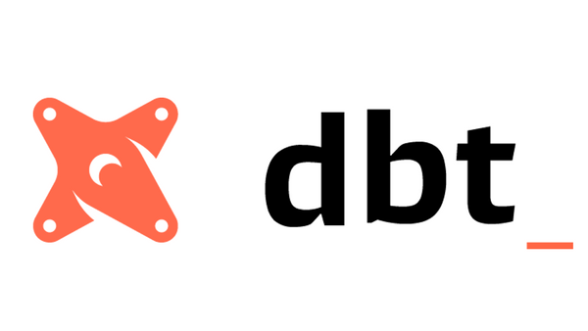
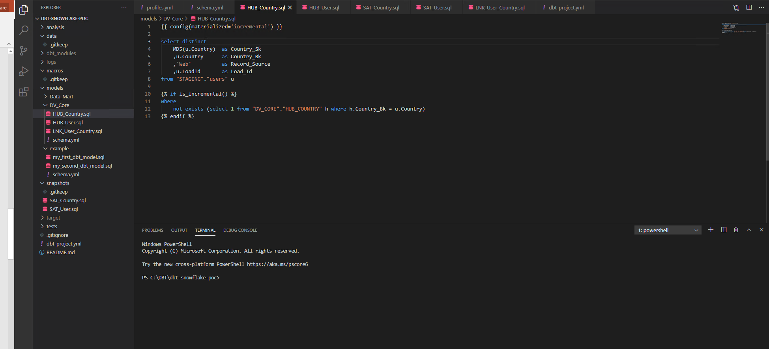
Using Airflow and DBT for DWH in Snowflake
DBT (data build tool):
DBT (data build tool) is a command line tool that enables data analysts and engineers to transform data in their warehouses more effectively. It enables analytics engineers to transform data in their warehouses by simply writing select statements. DBT handles turning these select statements into tables and views.
DBT does the T in ELT (Extract, Load, Transform) processes – it doesn’t extract or load data, but it’s extremely good at transforming data that’s already loaded into your warehouse.

Slide 5

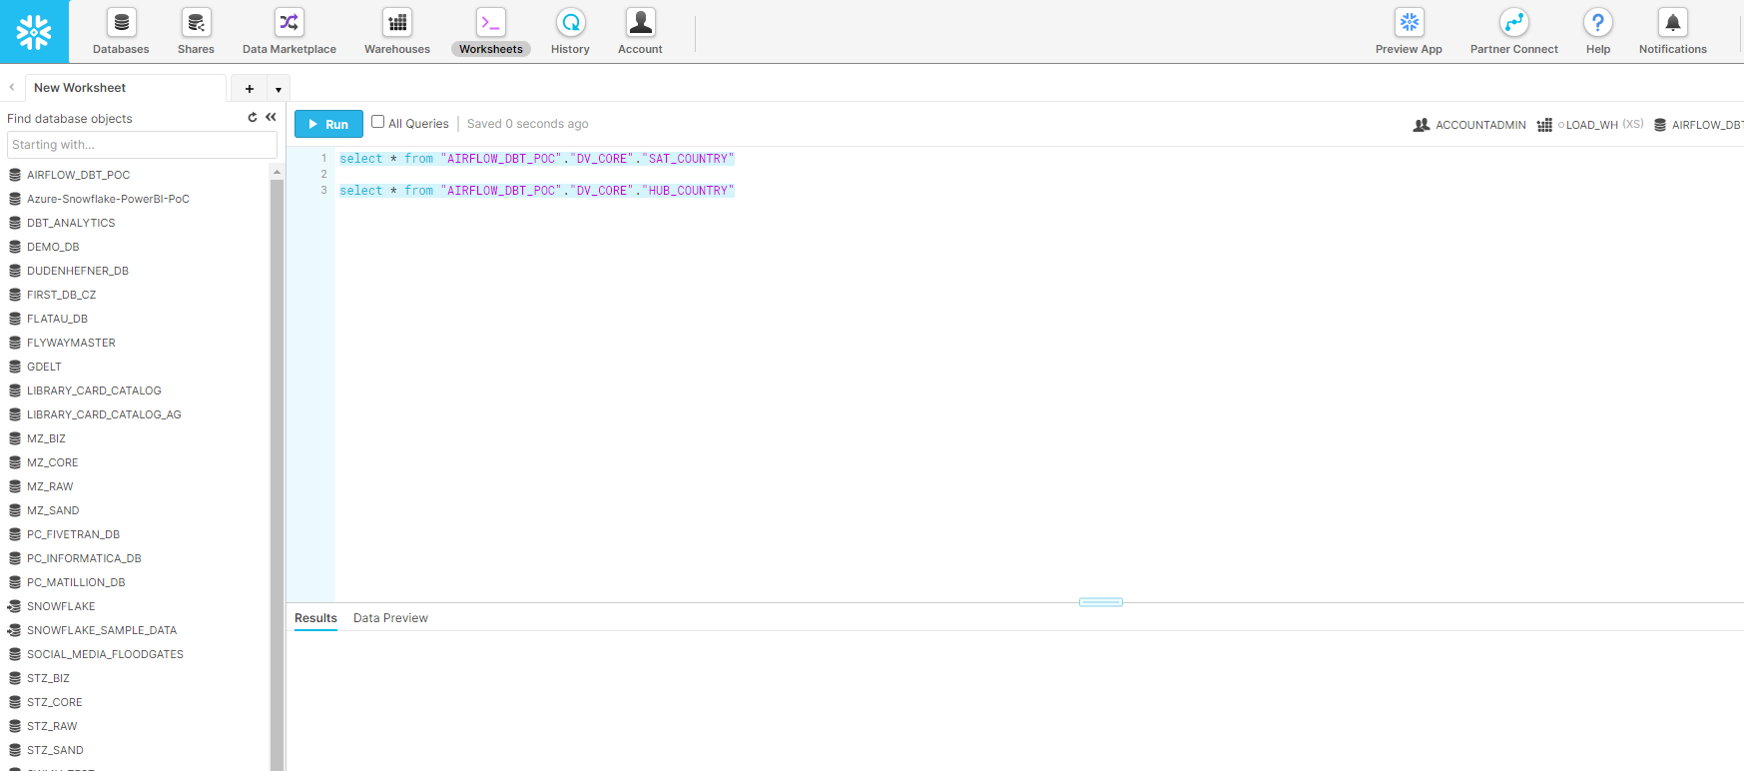
Using Airflow and DBT for DWH in Snowflake
Snowflake:
Snowflake’s Data Cloud is powered by an advanced data platform provided as Software-as-a-Service (SaaS). Snowflake enables data storage, processing, and analytic solutions that are faster, easier to use, and far more flexible than traditional offerings.
The Snowflake data platform is not built on any existing database technology or “big data” software platforms such as Hadoop. Instead, Snowflake combines a completely new SQL query engine with an innovative architecture natively designed for the cloud. To the user, Snowflake provides all of the functionality of an enterprise analytic database, along with many additional special features and unique capabilities.

Slide 6
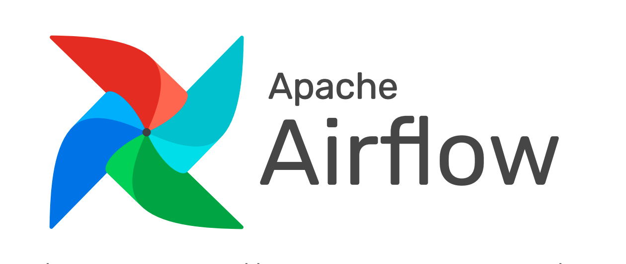


ELT Process (Tools)
Data Source
Data Extraction and Ingestion
Data Transformation
Data Storage

Slide 7

ELT Process (Environments)
Source Web Services are placed
Somewhere in the Internet
2 VMs (one for Airflow, one for DBT)
at the Microsoft Azure
Snowflake Cloud

